Slide 1
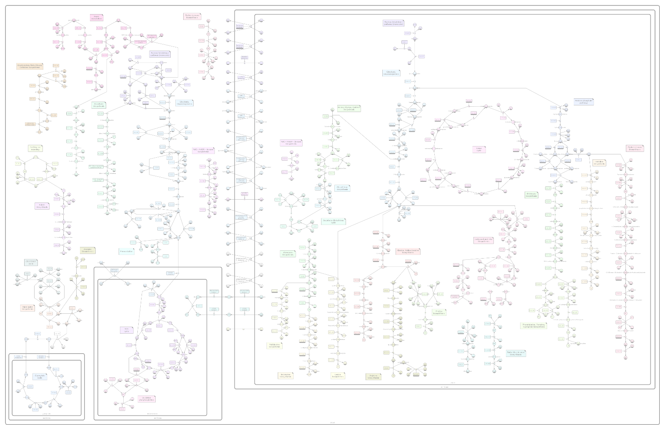

biographer simulator
A tool for interactive model simulation
Presentation by Matthias Bock
for the
Oberseminar of the Theoretical Biophysics Group
at the Humboldt-Universität zu Berlin
26th of April 2012
mail@matthiasbock.net

Slide 2
biographer
Systems Biologists want
meaningful visualizations!
SBGN = Systems Biology Graphical Notation
http://SBNG.org/

Slide 3
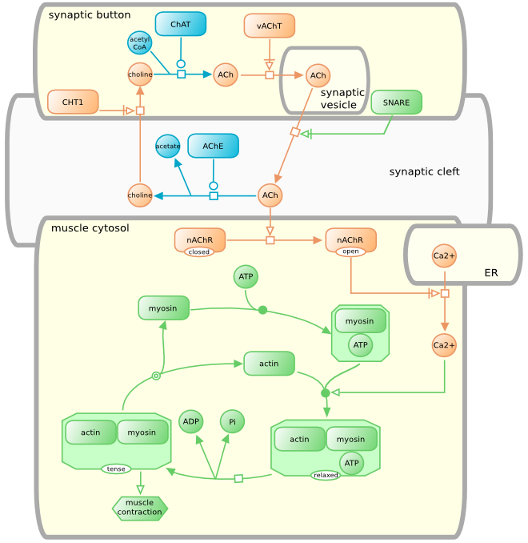
SBGN
SBGN
standardizes,
how nodes in
a model are
supposed to
look like
neuro-muscular junction
from http://sbgn.org/

Slide 4
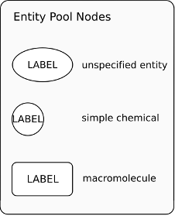
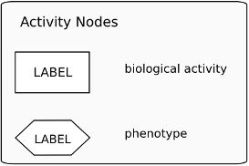
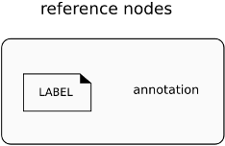
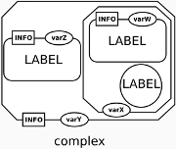
SBGN

Slide 5
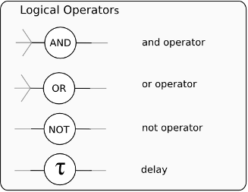
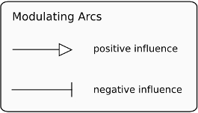
SBGN
and not only nodes, but also: interactions
this brought me to the idea ....

Slide 6
The challenge
„bringing life to modelled life“
visualize the network's activity state
inside it's SBGN illustration
bringing together modelling and testing

Slide 7
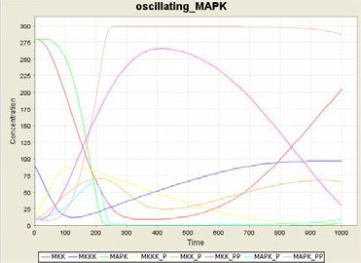
Theoretical models
1. model kinetics using equations:
* Copasi
2. model as Boole'an network using logical expressions:
* R
* BooleNet
Oscillating MAPK network
from CellDesigner Online Help

Slide 8
BooleNet
BooleNet Python library:
model = file of Update Rules
e.g.
* completely open-source
* runs platform-independent
* established solution for Boole'an network analysis
* enables extraordinary quick and easy modelling
# my example BooleNet model
Ras* = Glucose and GlucoseReceptor and (not Inhibitor)

Slide 9
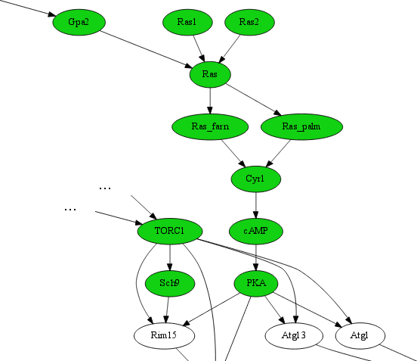
Visualization
Ras-cAMP-PKA pathway
simple rendering as
unspecified nodes;
logical operators not shown

Slide 10
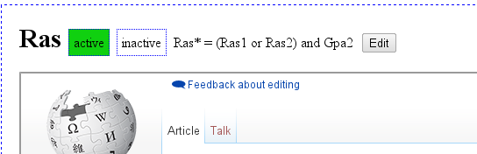
Interactivity
* click to simulate
* watch the progression of acitivitiy changes inside your network in „real time“
* click to see node annotation
* in-browser logic editor

Slide 11
State characterization
isn't simulation only with 0s and 1s kind of a too simple approach ?

Slide 12
State characterization
present/absent
active/inactive
phosphorylated/dephosphorylated
complexed/dissociated
receptor firing/off
gene transcription/silent
isn't simulation only with 0s and 1s kind of a too simple approach ?

Slide 13
State characterization
present/absent
active/inactive
phosphorylated/dephosphorylated
complexed/dissociated
receptor firing/off
gene transcription/silent
# States of Glucose: True=“present“, False=“absent“
isn't simulation only with 0s and 1s kind of a too simple approach ?

Slide 14

Annotations
1. single nodes
included via Python comment „# Annotation of ...“
e.g.
...
Glucose* = not metabolism
# Annotation of Glucose: „my energy source“
...
2. whole pathway
via SBGN labels
Ras pathway

Slide 15
Demonstration ...

Slide 16
Future aims
allow offline usage
SBML import/export
automated model generation
update rules controlling other node properties, e.g. localization
full SBGN conformity
in-browser modelling
different layouting possibilities
and fancy tablet support
(touch gestures: slide, zoom, node drag'n'drop)

Slide 17

Future aims
Thank you very much for your attention!
will be addressed in ...
http://code.google.com/p/biographer/wiki/Simulator

